Slide 1
Department of CSE,CSIT
COURSE NAME: Data science
COURSE CODE: 24AD3107
Topic:
Data Science Lifecycle –
CRISP-DM METHODOLOGY
Session - 3

Slide 2
AIM OF THE SESSION
To familiarize students with the basic concept of CRISP-DM Methodology in Data science
INSTRUCTIONAL OBJECTIVES
This Session is designed to: Introduction about CRISP-DM Methodology in Data Science
LEARNING OUTCOMES
At the end of this session, you should be able to: basic knowledge about CRISP-DM Methodology

Slide 3
Key Concepts
SESSION INTRODUCTION
Business Understanding
Data Understanding
Data Preparation
Modeling
Evaluation
Deployment

Slide 4
WHAT IS CRISP-DM METHODOLOGY?
Introduction:-CRISP-DM (Cross-Industry Standard Process for Data Mining) process is a robust, systematic framework for data mining projects. Its versatility has made it the industry standard for both small and large scale projects across various sectors.
Definition:-CRISP-DM stands for Cross-Industry Standard Process for Data Mining. It is a cyclical process that provides a structured approach to planning, organizing, and implementing a data mining project. The process consists of the below six major phases:
5

Slide 5
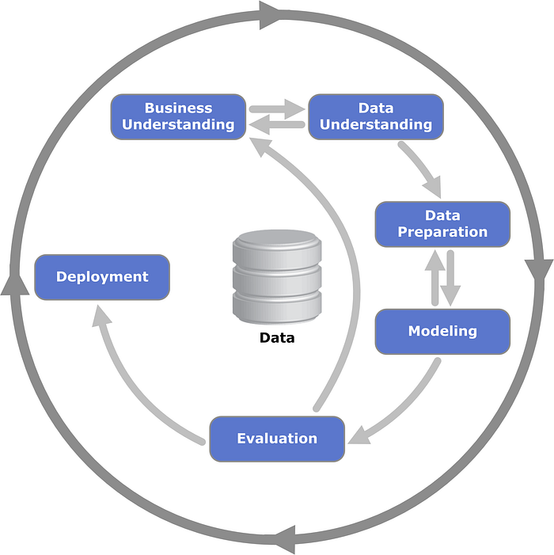
CRISP-DM METHODOLOGY
4

Slide 6
The Six Phases of CRISP-DM
1. Business Understanding
This initial phase focuses on understanding the objectives and requirements of the project from a business perspective.
Key tasks include:
Defining business objectives
Assessing the current situation
Determining data mining goals
Producing a project plan

Slide 7
The Six Phases of CRISP-DM
2.Data Understanding
Here, the data scientist begins the initial data collection and familiarizes themselves with the data.
Key tasks include:
Gathering initial data
Describing data
Exploring data
Verifying data quality

Slide 8
The Six Phases of CRISP-DM
3. Data Preparation
Data is rarely clean. This phase is dedicated to cleaning and transforming raw data into a suitable format for modeling.
Key tasks include:
Selecting data
Cleaning data
Constructing data (feature engineering)
Integrating data
Formatting data

Slide 9
The Six Phases of CRISP-DM
4. Modeling
With clean data in hand, various modeling techniques are applied. Each method may require specific data formats, so it’s not uncommon to loop back to the data preparation phase.
Key tasks include:
Selecting modeling techniques
Designing tests
Building the model
Assessing the model

Slide 10
The Six Phases of CRISP-DM
5. Evaluation
Before proceeding to deployment, the model’s performance is thoroughly evaluated. This ensures that it meets the business objectives set in the first phase.
Key tasks include:
Evaluating results
Reviewing the process
Determining the next steps

Slide 11
The Six Phases of CRISP-DM
6. Deployment
The final phase involves deploying the model into a real-world environment. This can be as simple as generating a report or as complex as implementing a repeatable data mining process.
Key tasks include:
Planning deployment
Monitoring and maintenance
Reviewing the project
Finalizing the project

Slide 12
Why Use CRISP-DM?
Versatility: It’s industry-agnostic, meaning it can be applied across various sectors and business problems.
Structured Approach: It provides a clear roadmap for data mining projects, ensuring that crucial steps aren’t overlooked.
Iterative: Given its cyclical nature, it encourages continuous improvement. If a problem arises in one phase, you can loop back to an earlier phase.

Slide 13
CONCLUSION
The CRISP-DM process offers a robust framework that guides data scientists and analysts in executing successful data mining projects. Its structured yet flexible approach ensures that all critical aspects of a project are addressed, from understanding the business problem to deploying the solution. Whether you’re new to data science or a seasoned pro, incorporating CRISP-DM into your workflow can enhance the efficiency and effectiveness of your projects.

Slide 14
DATA SCIENCE TOOLS AND TECHNOLOGIES
A. Programming Languages
Python
R
B. Data Visualization Tools
Tableau
Power BI
C. Machine Learning Libraries
Scikit-learn
TensorFlow
D. Big Data Frameworks
Apache HadooP
Apache Spark

Slide 15

THANK YOU
Team – DS

